Slide 1
Fault prediction for bearings Anomaly detection with Deep Learning
Author:
Linkedin:
Github:
Robert Anglberger
www.linkedin.com/in/robert-anglberger
https://github.com/devbert/Fault-prediction-for-bearings-anomaly-detection-

Slide 2
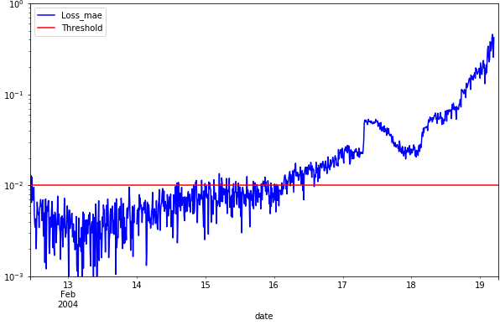
Fault prediction for bearings Anomaly detection with Deep Learning
3 days before crash!
Author:
Linkedin:
Github:
Robert Anglberger
www.linkedin.com/in/robert-anglberger
https://github.com/devbert/Fault-prediction-for-bearings-anomaly-detection-

Slide 3
Agenda
Functional
Use Case
Data Set
Technical
Data Preparation
Data Exploration
Modeling
Model Performance
Solution
Data Products

Slide 4
Functional
Use Case
Data Set
Solution
Data Products

Slide 5
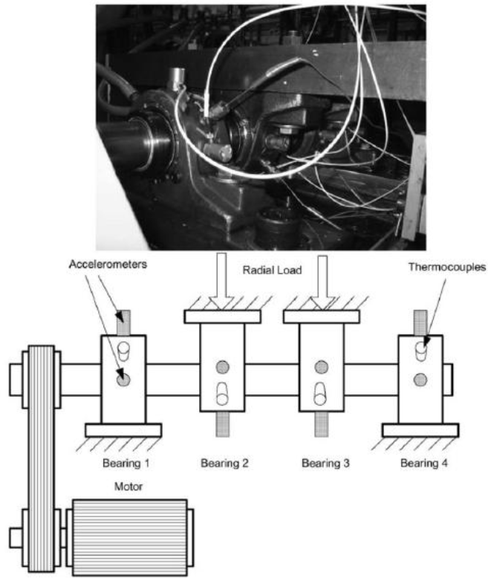
Use Case
Functional
Motor with 4 bearings installed on a shaft
Goal: predict when the bearings should be maintained or replaced

Slide 6
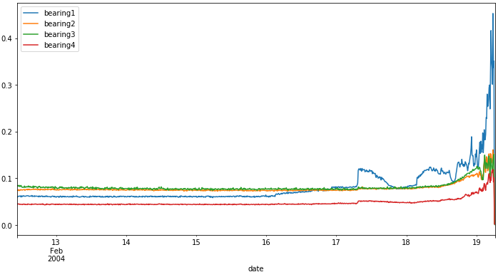
Data Set
Functional
IoT sensor data from 4 bearings
Recording duration: Feb 12th 2004 – Feb 19th 2004
984 files / 20,840 records per file
File recording interval: Every 10 min
At the end of the test-to-failure experiment outer race failure occurred in bearing 1

Slide 7
Solution
Functional
3 days before crash!
Deep Learning Neural Network and KNN
IBM Cloud with Watson Studio
Jupyter Python Notebook
Very low need of system resources (storage volume, CPU, RAM…)
Notes:
I only had 1 vCPU and GB Ram available in my cloud environment so I took care about storage volume and system performance

Slide 8
Functional
Coding - separated
bearing.etl.python.01.ipynb
bearing.model_def.python.07.ipynb
bearing.model_train.python.02.ipynb
bearing.model_evaluate.python.01.ipynb
Data Products
Coding – all in one
bearing.model_deployment.python.03.ipynb
Presentation
Presentation file for Stakeholders and for technical audience

Slide 9
Technical
Data Preparation & Exploration
Modeling
Model Performance

Slide 10
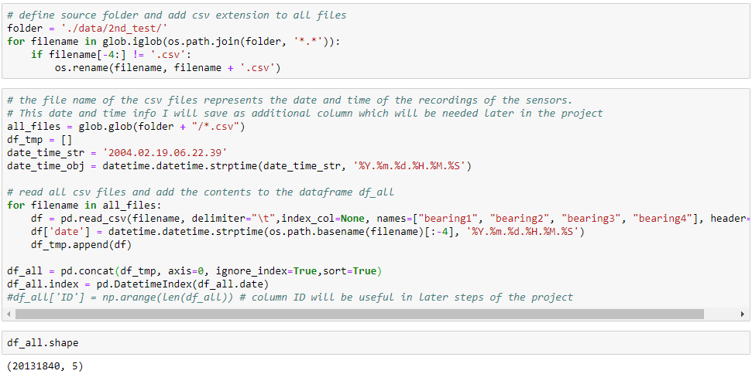
Technical
ETL
Data load from local file system
Data Transformation and loading to python dataframe

Slide 11
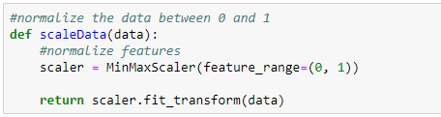
ETL
Technical
Data Sampling (10 min intervals)
Data Scaling
Data Visualization

Slide 12
Modeling
Technical
Unsupervised machine learning
Autoencoder Neural Network with LSTM
Autencoder Neural Network
KNN Classification
Notes:
We have to deal with unsupervised machine learning because we have no idea which parts of the measure points are normal and which are not. Which means we have no classification with good or bad

Slide 13
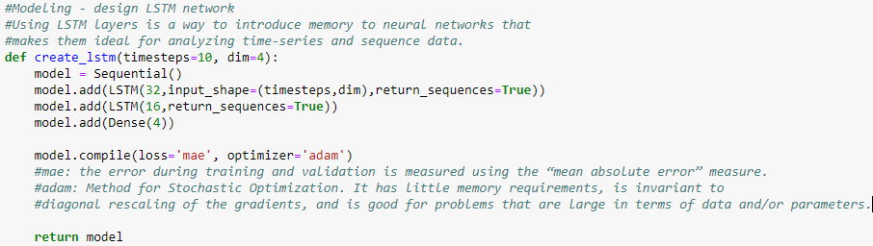
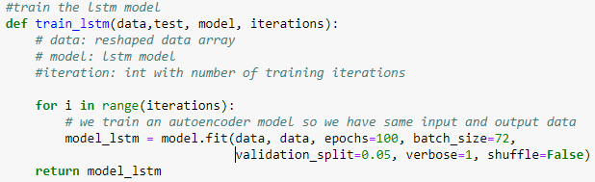
Recurrent NN with LSTM
Technical
LSTM (long-short term memory)
Autoencoder
Notes:
Autoencoder: The aim of an autoencoder is to learn a representation (encoding) for the bearing IoT data for dimensionality reduction by training the network to ignore signal “noise”. Along with the reduction side, a reconstructing side is learnt, where the autoencoder tries to generate from the reduced encoding a representation as close as possible to its original input

Slide 14
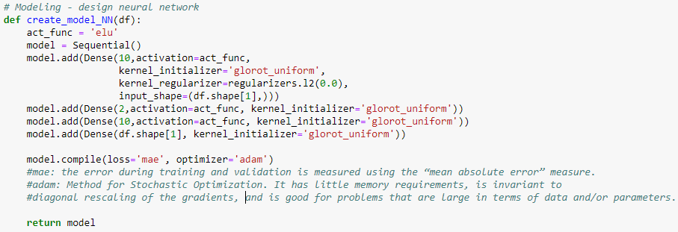
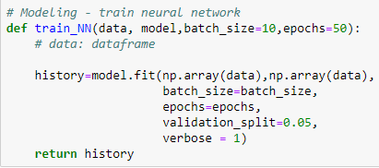
Recurrent NN without LSTM
Technical
Only with Dense Layers
Autoencoder
Disadvantages compared to LSTM
Gradient vanishing and exploding problems
It cannot process very long sequences if using tanh or relu as an activation function.

Slide 15

KNN Classification
Technical
Installed from package pyod
Anomaly detection in multivariate data
k Nearest Neighbors uses the distance to the kth nearest neighbor as the outlier score
Notes:
Method: median, mean, largest which did not make a big difference in our bearing case

Slide 16
Performance evaluation
Technical
Get loss of training data and identify threshold for anomaly
Plot the calculated loss distribution with threshold
Interpretation of result with domain expert
Notes:
By plotting the distribution of the calculated loss in the training set I can use this to identify a suitable threshold value for identifying an anomaly. In doing this, I can make sure that this threshold is set above the “noise level”, and that any flagged anomalies should be statistically significant above the noise background

Slide 17
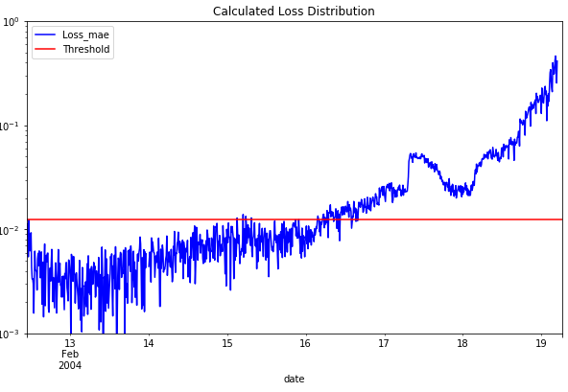
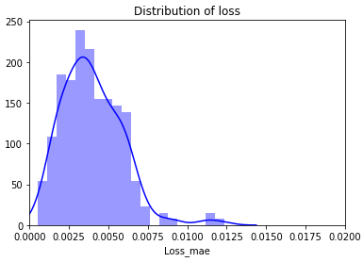
Performance LSTM model
Technical

Slide 18
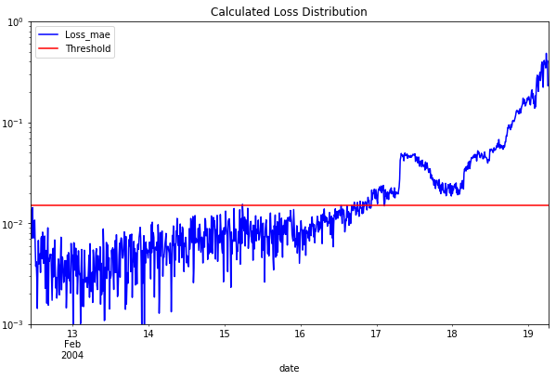
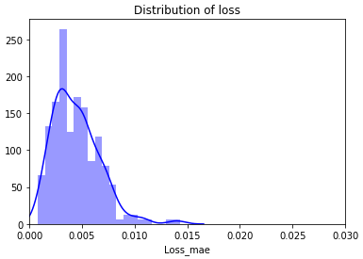
Performance Recurr NN
Technical

Slide 19
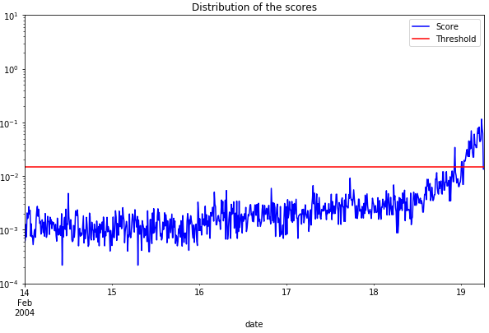
Performance KNN
Technical

Slide 20
Result Summary
Technical
Similar result for both NN networks in this case
No good classification result for KNN

Slide 21
Possible improvements
Technical
Model parameter optimization
Further code cleaning and optimization (e.g. use of object store instead of csv)
Use of Spark ML to improve scalability and performance
Use of SAP HANA database to improve performance
etc…..

Slide 22
THANKS!
Any questions?
www.linkedin.com/in/robert-Anglberger
All coding and the presentation is available on GitHub:
https://github.com/devbert/Fault-prediction-for-bearings-anomaly-detection-
22

